Slide 1
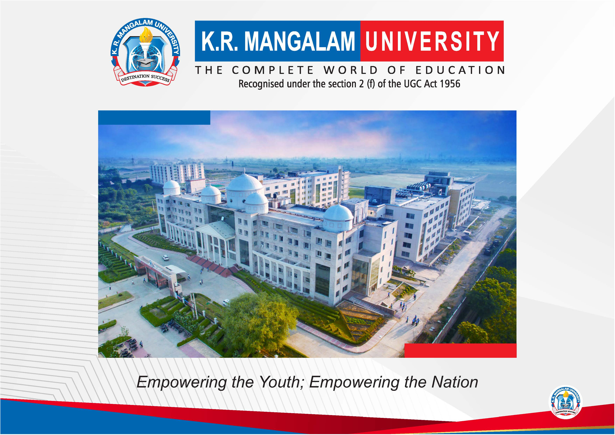

Slide 2


AI-Based-Smart-Eco-Air-Pollution-Control-System
Pre-Final Year Project Synopsis
Submitted by
ROLL | NAME
2301730100 | Shubham
2301730126 | Suryansh
Faculty Mentor: Mr. Anurag Singh
Notes:
New Courses replaced with New Programmes

Slide 3

Project Overview
Air pollution is a major environmental and health challenge, especially in urban and semi-urban regions.
A significant amount of pollution originates from point sources such as industrial chimneys, workshops, enclosed spaces, and poorly ventilated areas.
Existing air purification systems are:
  Mostly designed for indoor environments
  Expensive and difficult to maintain
  Dependent on synthetic, non-biodegradable filters
Conventional solutions work after pollution has already dispersed, making them inefficient and energy-intensive.
Lack of real-time intelligence and adaptive response further reduces system efficiency.
➡️ Hence, there is a need for a low-cost, eco-friendly, intelligent system that controls pollution directly at the source before it spreads.
Notes:
New Courses replaced with New Programmes

Slide 4
Specific Objectives
To design an IoT-based air pollution control system for source-level pollution reduction.
To utilize eco-friendly materials such as bamboo and charcoal for sustainable air filtration.
To monitor air quality in real time using PM2.5 and gas sensors.
To implement automatic system activation based on pollution threshold levels.
To integrate AI-based decision logic for adaptive purification control.
To ensure low cost, scalability, and suitability for both indoor and outdoor environments.
Notes:
New Courses replaced with New Programmes

Slide 5
Key Features
✅ Source-level pollution control
✅ Real-time IoT monitoring
✅ AI-driven automation
✅ Eco-friendly filtration
✅ Low-cost and scalable
✅ Automatic Threshold – based Automation
✅ Indoor and Outdoor Deployment support
✅ Energy efficient Operations .
Notes:
New Courses replaced with New Programmes

Slide 6
Project Usecases
Industrial Areas & Chimneys
Can be installed near industrial chimneys and emission points to reduce pollution at the source.
Workshops and Manufacturing Units
Controls dust, smoke, and harmful gases generated during manufacturing processes.
Commercial and Public Spaces
Suitable for malls, parking areas, markets, and other high-footfall zones with poor ventilation.
Educational Institutions
Can be deployed in classrooms, laboratories, and corridors to improve indoor air quality.
Semi-Urban and Rural Locations
Effective in areas lacking access to expensive air purification infrastructure.
Indoor Enclosed Spaces
Helps maintain healthier air in rooms, basements, and storage areas.
Notes:
New Courses replaced with New Programmes

Slide 7
Project Scope
Focuses on localized, source-level air pollution control rather than ambient air purification.
Supports real-time air quality monitoring using IoT sensors.
Enables automatic and intelligent operation through AI-based decision logic.
Promotes eco-friendly and sustainable filtration using bamboo and charcoal.
Designed for low-cost implementation and scalability for wider adoption.
Can be extended to include cloud monitoring, mobile applications, and advanced ML-based prediction in future versions.
Notes:
New Courses replaced with New Programmes

Slide 8
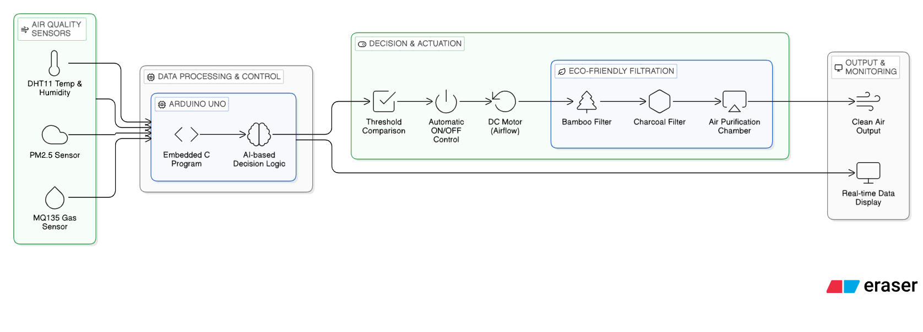
Prototype/Project Flow diagram/Architecture
Notes:
New Courses replaced with New Programmes

Slide 9
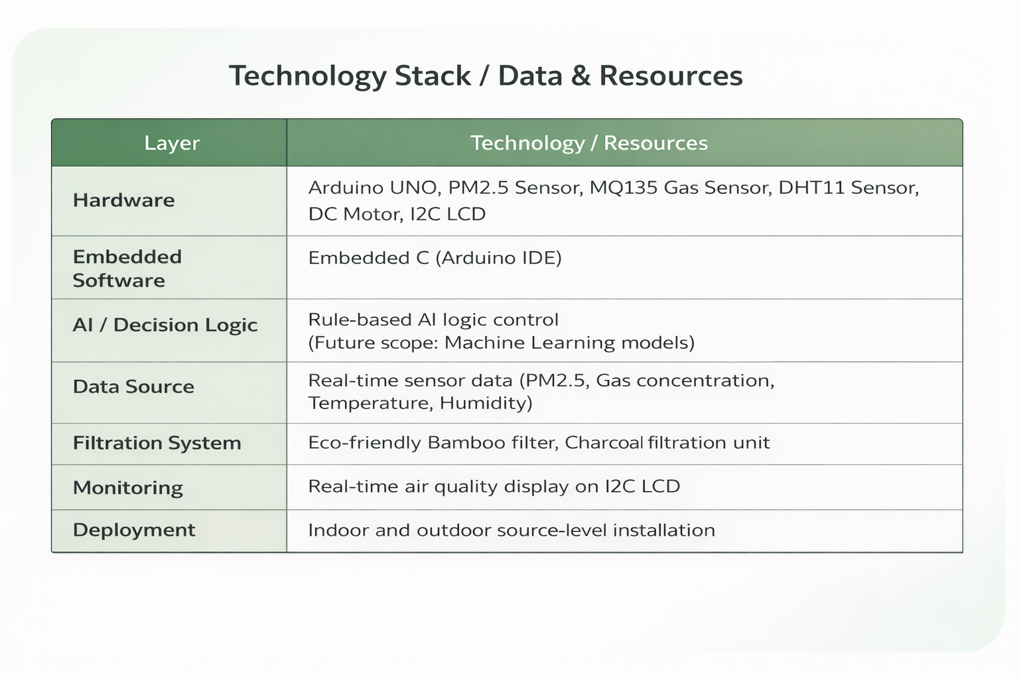
Data & Resources
Notes:
New Courses replaced with New Programmes

Slide 10
Expected Results & Impact
                ✅ Reduction in air pollution at source locations
                ✅ Improvement in local air quality
                ✅ Real-time monitoring of pollution levels
                ✅ Automatic and efficient system operation
                ✅ Eco-friendly alternative to synthetic filters
                ✅ Low-cost solution suitable for wide deployment
Notes:
New Courses replaced with New Programmes

Slide 11
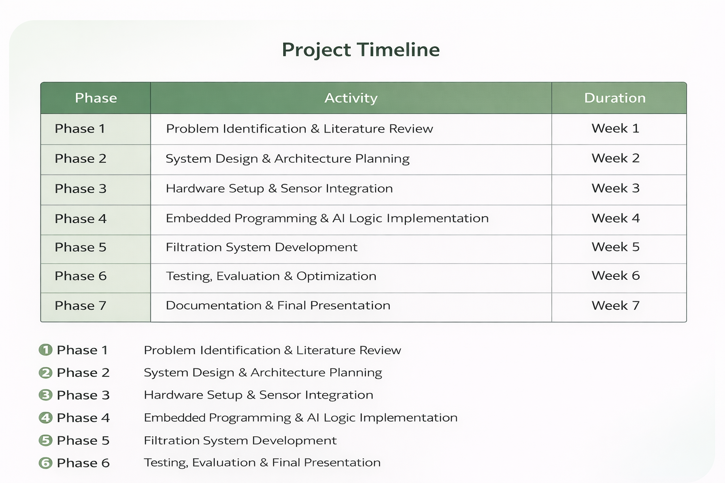
Project Timeline
Notes:
New Courses replaced with New Programmes

Slide 12
THANK YOU

